Slide 1
Particle Filter
PF and EKF/UKF

Slide 2
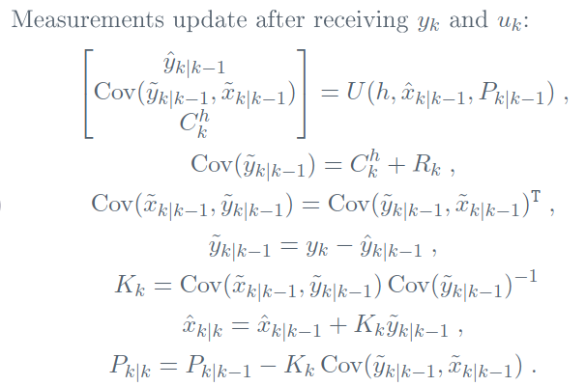
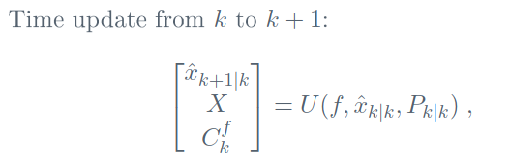
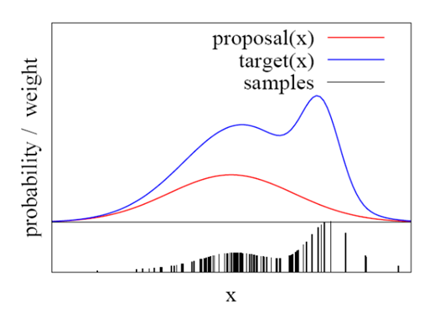
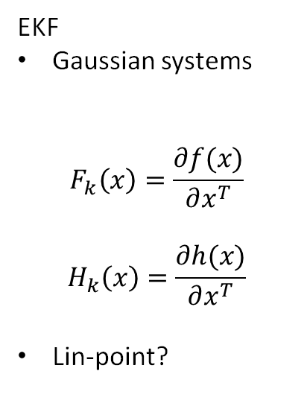
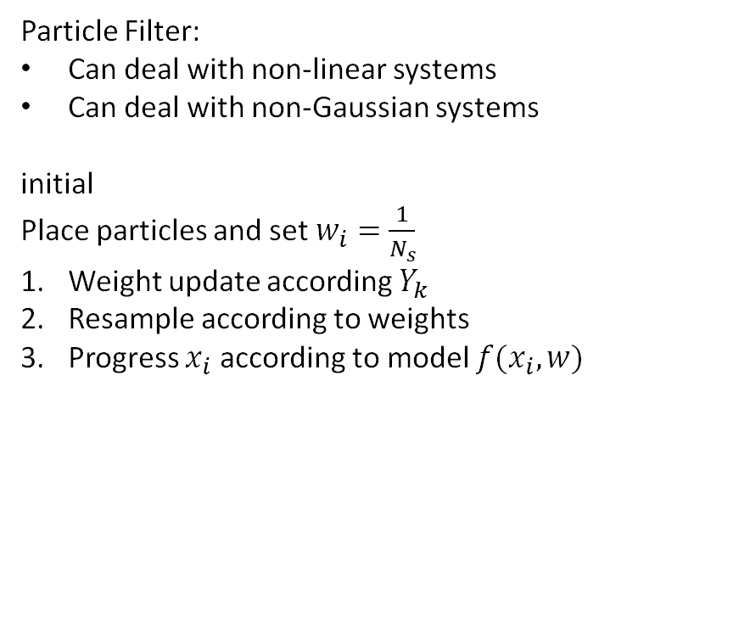

EKF/UKF vs. Particle Filter
EKF
Gaussian systems
$$F_{k}\left(x\right)=\frac{∂f(x)}{∂x^{T}}$$
$$H_{k}\left(x\right)=\frac{∂h(x)}{∂x^{T}}$$
Lin-point?
UKF
Gaussian systems
Sigma points and weights acc. to UT algorithm
$${\hat{x}}_{k|k−1}=\sum{w_{i}^{m}x_{i}}={\hat{x}}_{k|k−1} \\ {\hat{C}}_{xx}=\sum{w_{i}^{c}(x_{i}−\hat{x})(x_{i}−\hat{x})} \\ {\hat{C}}_{yx}=\sum{w_{i}^{c}\left(\left(h\left(x_{i}\right)−\hat{y}\right)\left(x_{i}−{\hat{y}}_{k|k−1}\right)\right)}$$
Particle Filter:
Can deal with non-linear systems
Can deal with non-Gaussian systems
initial
Place particles and set $w_{i}=\frac{1}{N_{s}}$
Weight update according $Y_{k}$
Resample according to weights
Progress $x_{i}$ according to model $f(x_{i},w)$

Slide 3

Differences
$UKF$ places sigma points carefully around estimated state
$PF$needs a lot particles relative to UKF and is therefor more computational expensive
UKF estimation error does not goes to zero
PF estimation error goes to 0 for $\#particles →∞$

Slide 4
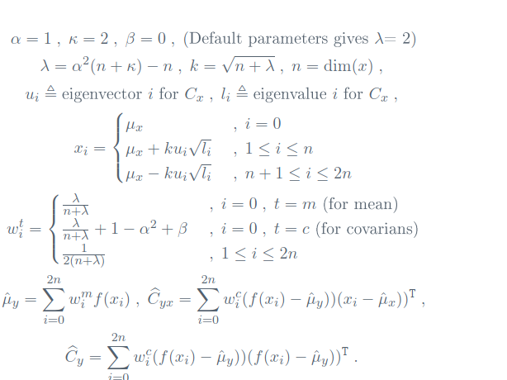

Slide 5
Unscented transform

